Slide 1
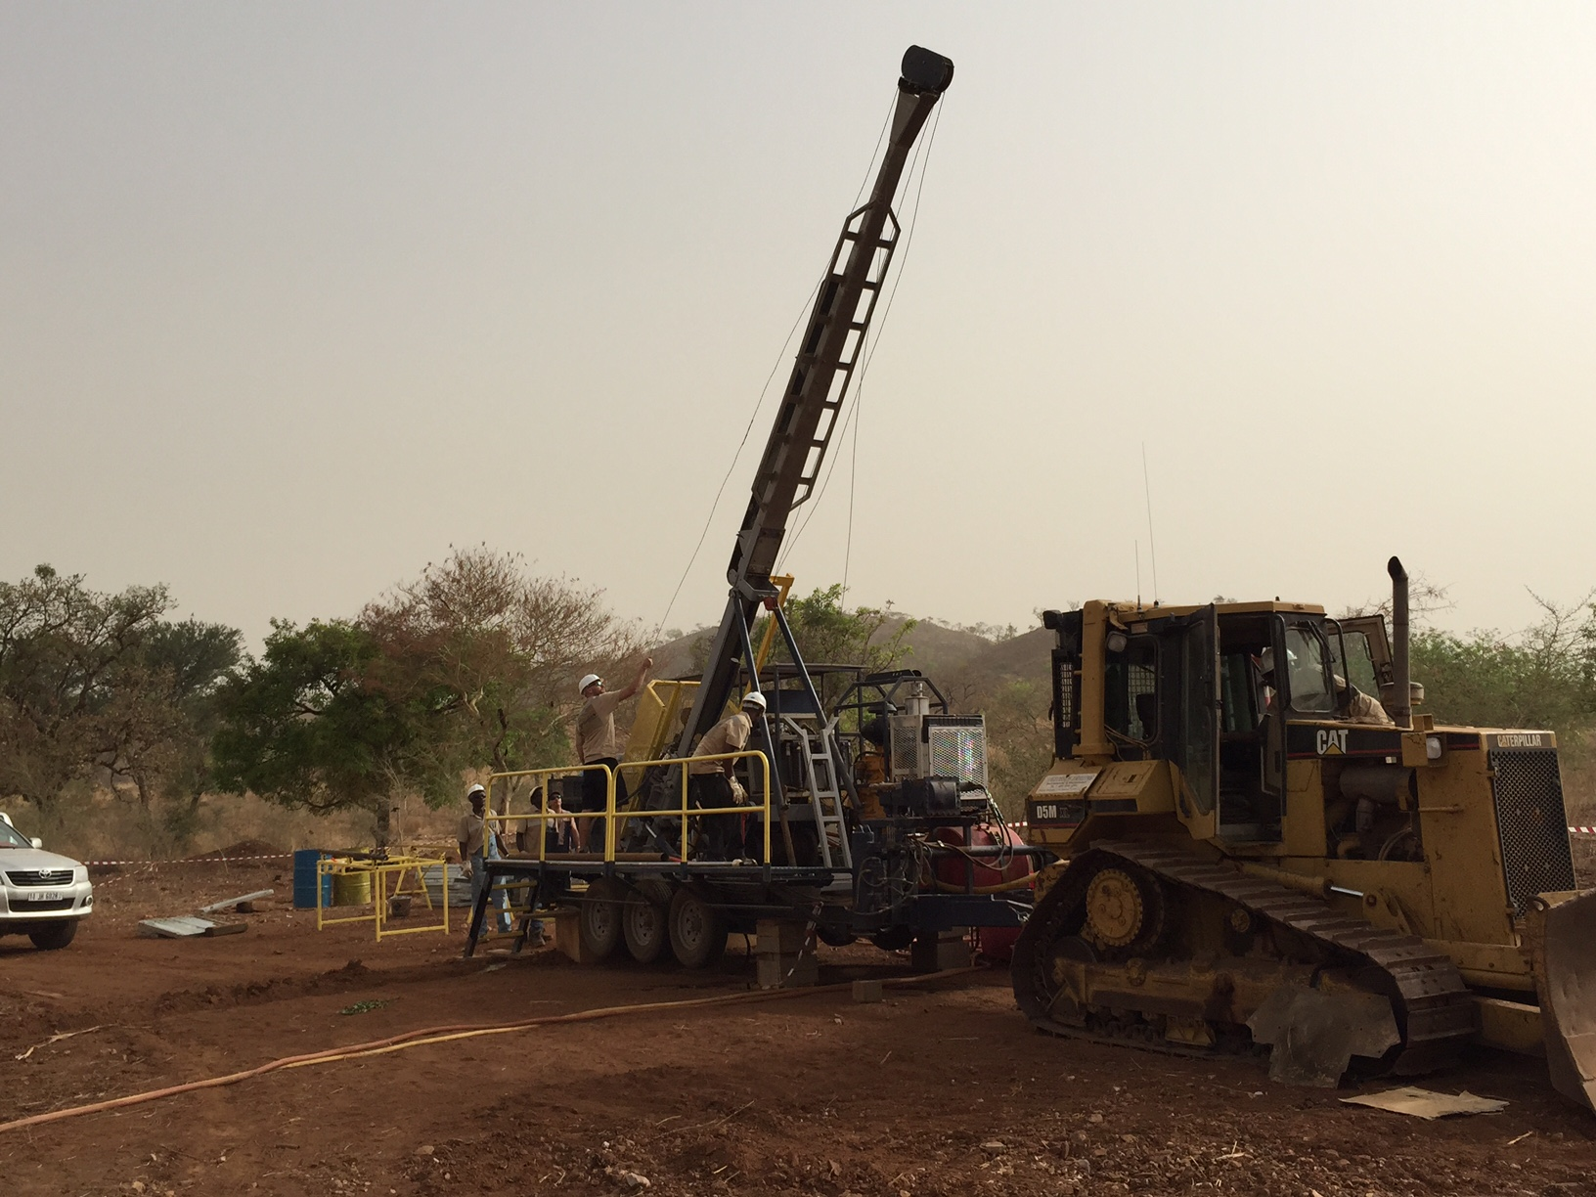

Drilling In Africa:
Lessons Learned

Slide 2
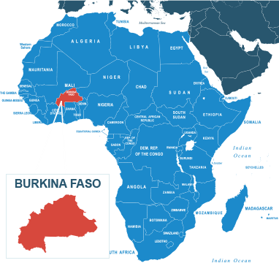

Lesson Learned 1: Importation
Understanding importation liabilities associated with assets and consumables
Tax rates can fluctuate from 10% to 48% depending on goods
Understanding HS codes and the tax implications
Exoneration limitations and transfer of assets
Importation inspections and paperwork associated

Slide 3

Lesson Learned 2: Customs
Expectations on corruption and delays associated
Interpretation on goods and what is considered appropriate for labeling of items
Paperwork alignment
Greater delays when requesting exoneration on shipments
Delays, associated with process in general
Proper inter-company invoicing to comply with Bank/Gov’t expectations for goods to be shipped

Slide 4
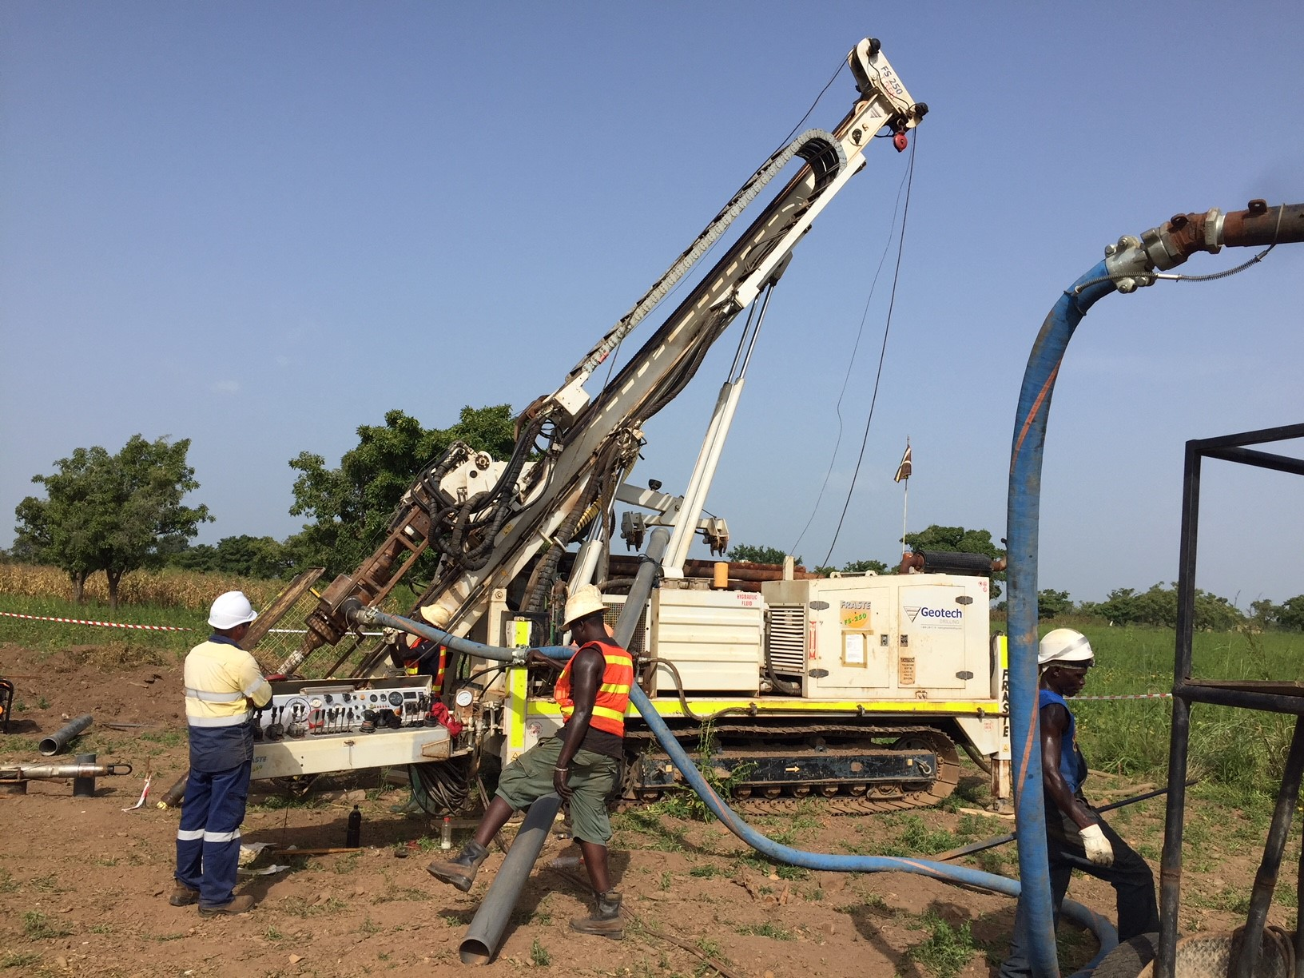
Lesson Learned 3: Logistics
Limited infrastructure for movement of goods/equipment
Land locked countries make for more challenges
Expensive to truck vs rail, limited on size/weight and extreme delays
Minimum 10-14-day windows for shipping emergency parts if required
Expectations of increased cost of goods by 10% for program costs vs North American programs

Slide 5
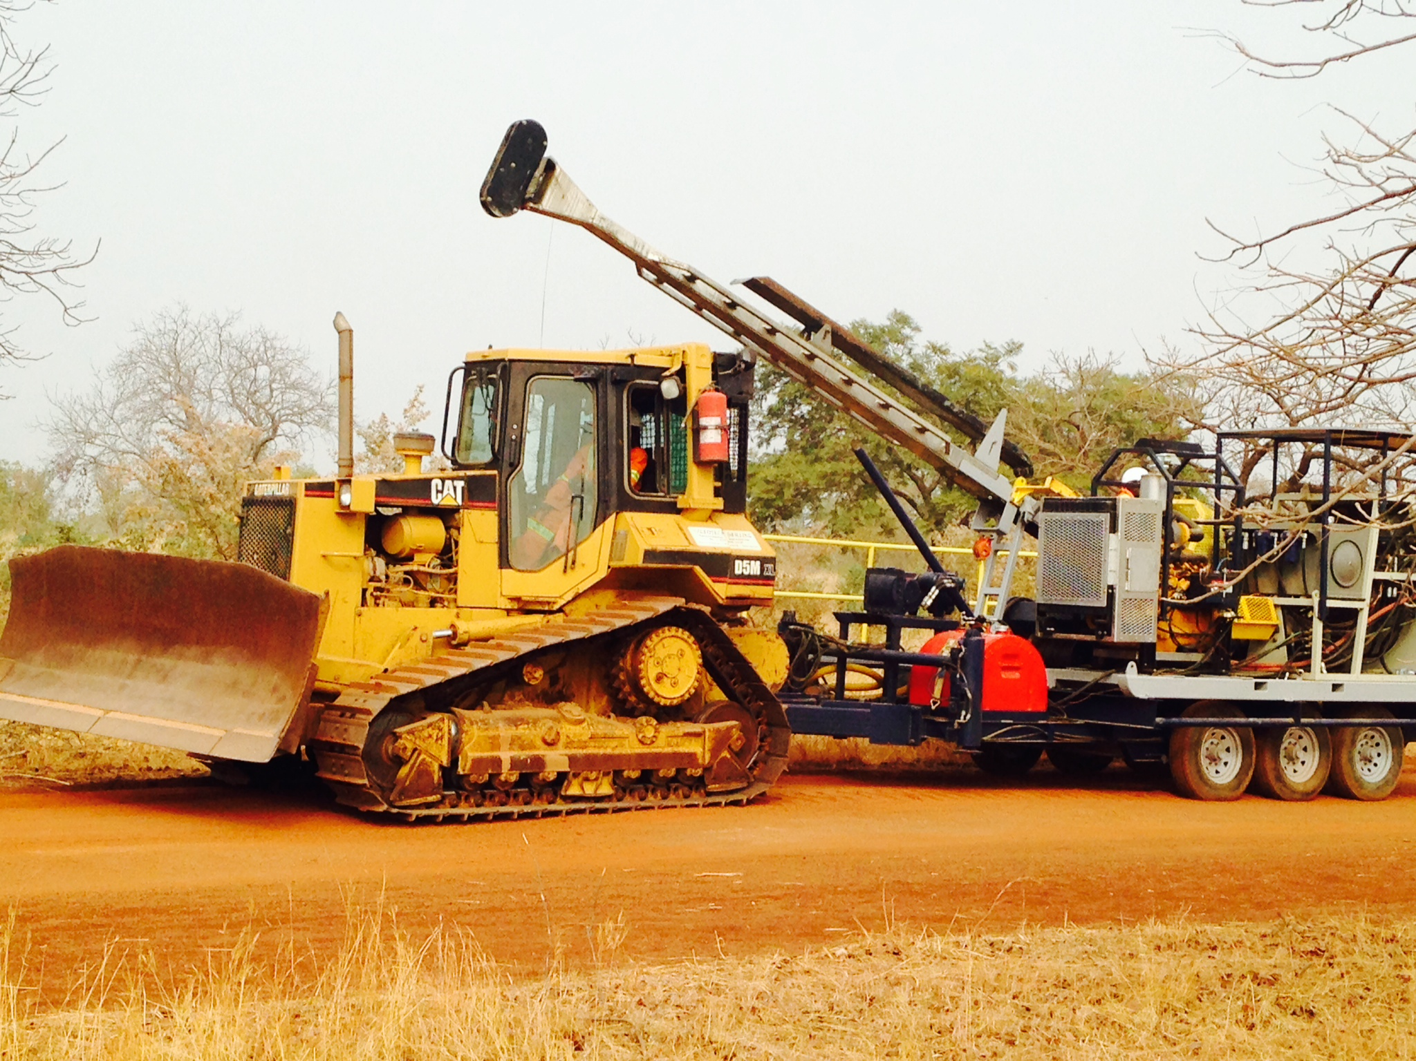
Lesson Learned 4: Supply Chains
Extremely limited for all supplies
3-4 month planning windows for the most cost-efficient shipping methods
Inventory and cash flow planning can be challenging
In country goods can be of lesser quality, expensive and sometimes don’t show up.
Establish payables direct from country to streamline financials

Slide 6
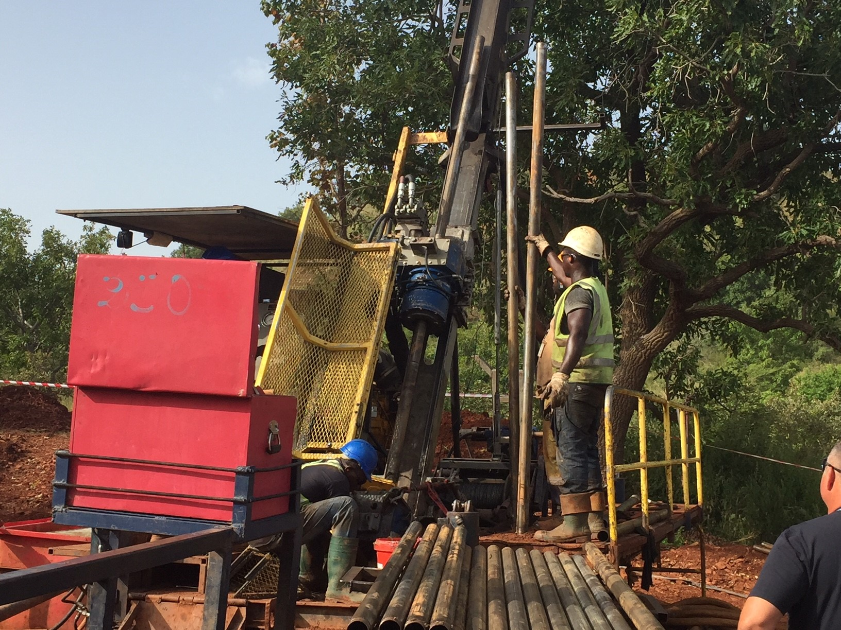
Lesson Learned 5: Taxation
Understanding withholding tax application: how it applies from clients and how it applies for inter-company invoicing
Tax treaties if applicable. Does this exist and what applies?
Ex-pats and costs associated
VAT and applications – don’t qualify as a contractor

Slide 7
Lesson Learned 6&7: Weather / Geopolitical
Extreme heat and the impact on equipment
Rainy seasons (Africa’s winter), and impact on forecasting
Protecting your employees (ex-pats)
Risk potential for government regime change (Coup)
Tariff and tax changes (immediate, poorly communicated, etc.)

Slide 8
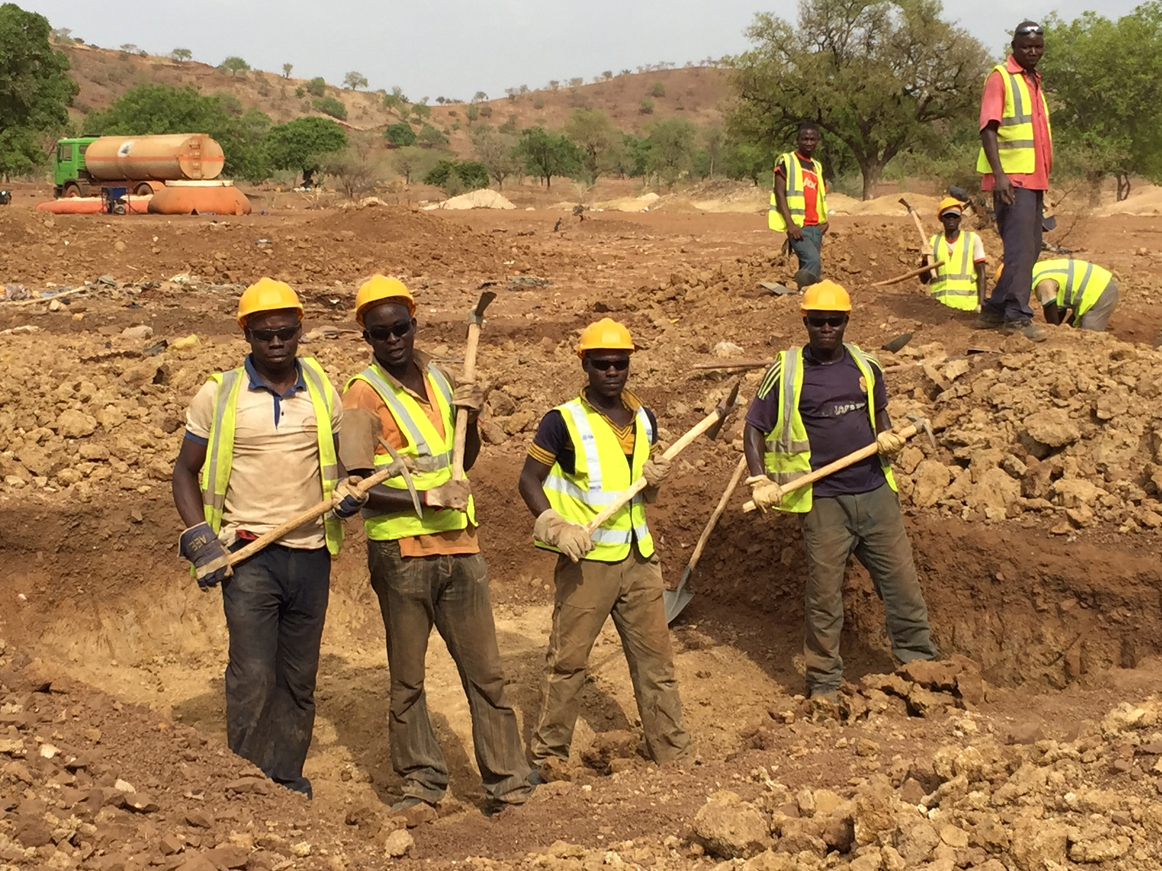
Lesson Learned 8: Personnel
Training and experience – takes a substantial amount of time to culture employees – they don’t see what we do
Contracts and Obligations
Wear and tear (increase)
HSE risk reduced because of # of personnel

Slide 9
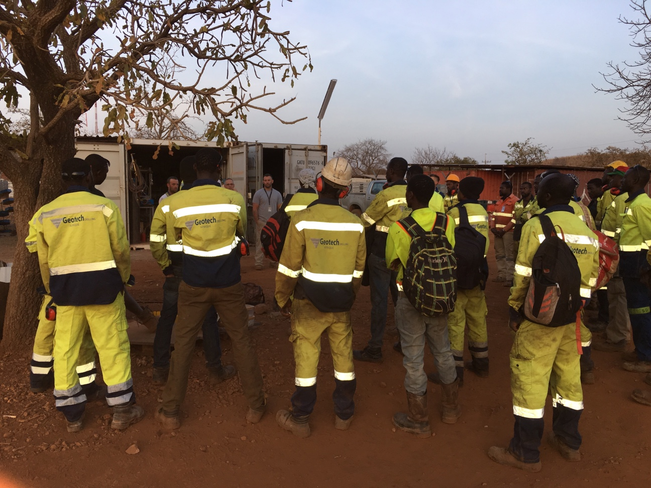
Lesson Learned 11: Invoicing & Cashflow
Exchange rate losses - having to be paid in local currency
Proxy planning, acceptance from Banks and vetted by Gov’t
Delays on wire transfers
Importation reconciliation which includes all documentation such as:
          Import permits
          Clean Record of Inspection
          Commercial Invoices
          Packing Lists
          Original Bill of Lading

Slide 10
Why we do it???
Opportunity to change someone’s life forever for the better
Giving back to the communities we work in. Programs for local education and donations
Greater return for greater risk

