Slide 1
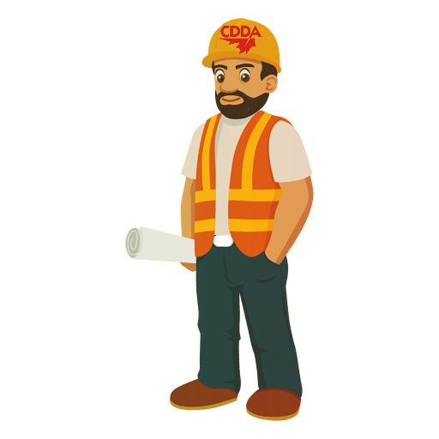
Welcome CDDA Members!
Virtual Eastern and Western Safety Conference
March 3rd, 2021

Slide 2
Agenda
10:00 am-Attendance, Speakers Chris Drenth and Gerald Cooke
10:30 am- Members Safety Share (We are now taking submissions,
11:00 am- WSIB Excellence Program- Lisa Dupuis
11:30 am- “Drilling deeper into data: 15 years of the Canadian Mineral Exploration Environment, Health & Safety Survey”
Presentation by: Jonathan Buchanan, Director, Regulatory and Technical Policy AME | Association for Mineral Exploration and Bill Mercer, PhD, P.Geo, Chair, Health & Safety Committee PDAC | Prospectors & Developers Association of Canada; : Rebecca Bond, a Master of Human Kinetics candidate, with the Centre for Research in Occupational Safety and Health (CROSH)
12:00 pm- “How corrosion affects the mining industry”
Presentation by: Zoe Coull PhD PEng, Professional Engineer and Brycklin Wilson, MaSc, PEng, Senior Corrosion Specialist
12:30 pm- 4th Quarter 2020 Safety Awards and CDDA Announcements

Slide 3
Safety Shares

Slide 4
WSIB
Health and Safety Excellence Program
Lisa Dupuis, CDMP
Northern Ontario Regional Consultant
Health and Safety Excellence Program

Slide 5
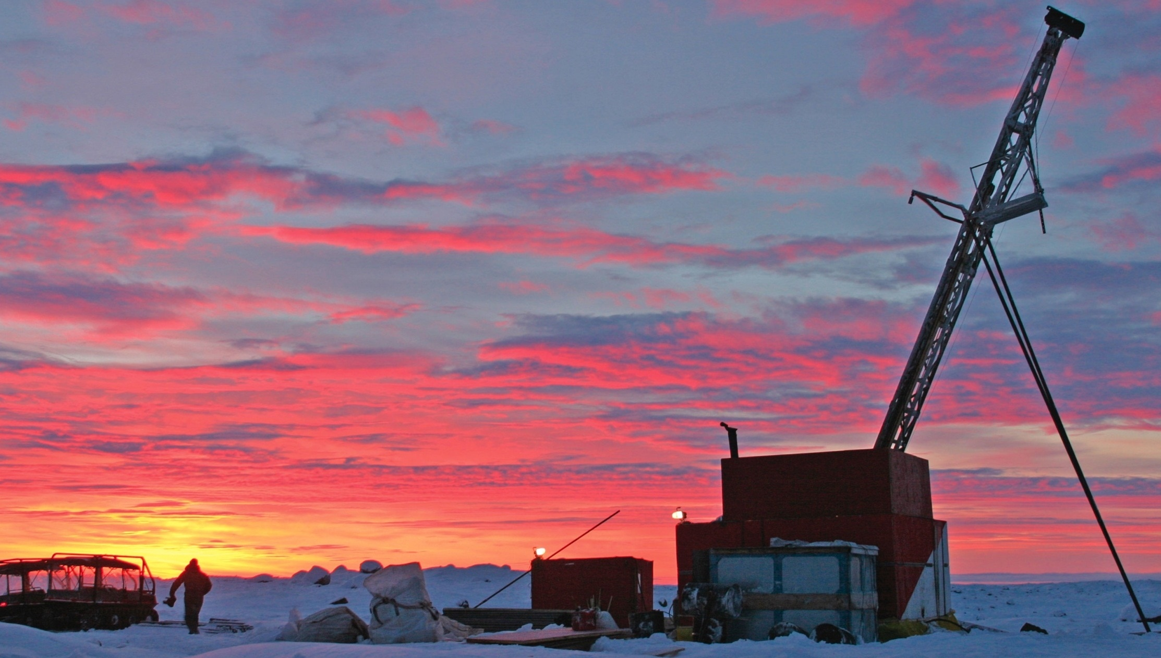

THE PDAC-AME SURVEY of Health and Safety in Mineral Exploration
Jonathan Buchanan*, Bill Mercer@, Rebecca Bond#,
* - Director, Regulatory and Technical PolicyAME;
@ - VP, Exploration, Avalon Advanced Materials Inc
# - Masters Student – CROSH, Laurentian University
March 3rd, 2021
Notes:
Introduction – ask some questions of the audience

Slide 6
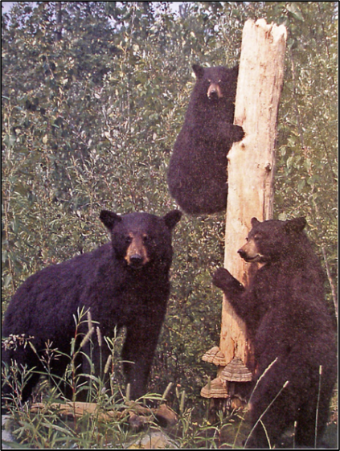
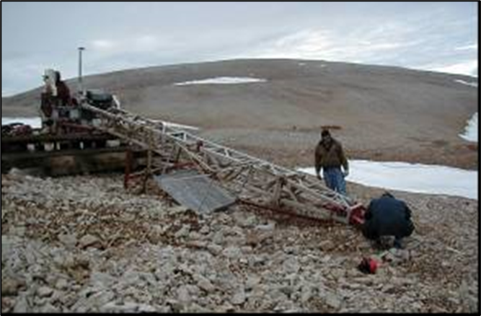
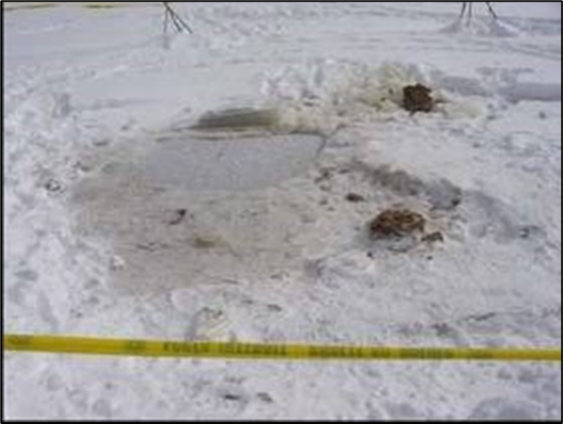
We are all in this together
Geologist with 45 years in exploration
During that time, 3 fatalities at company where I worked for thirty years – one/10 years
  (none for 15 years)
All three were drill crew members

Slide 7
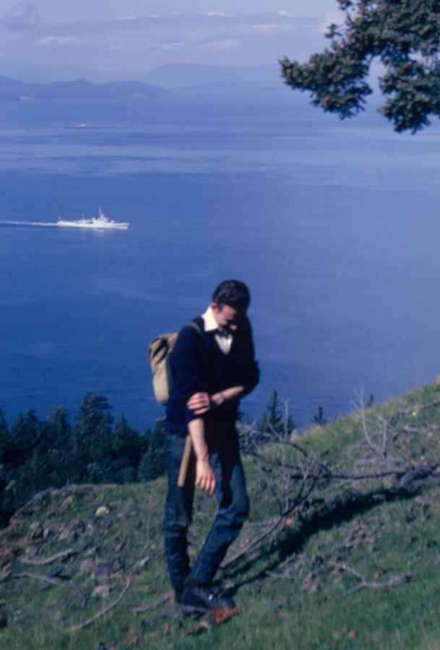
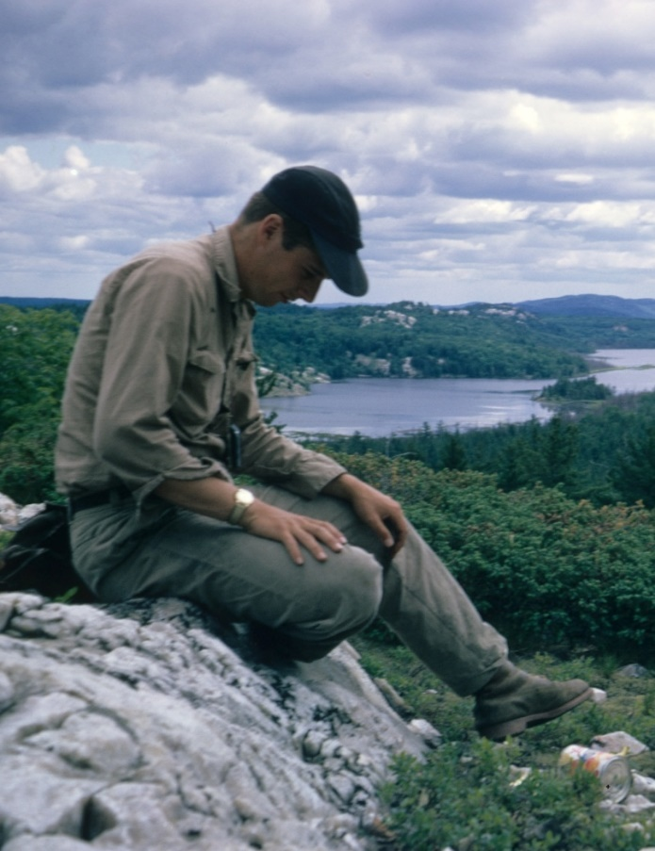
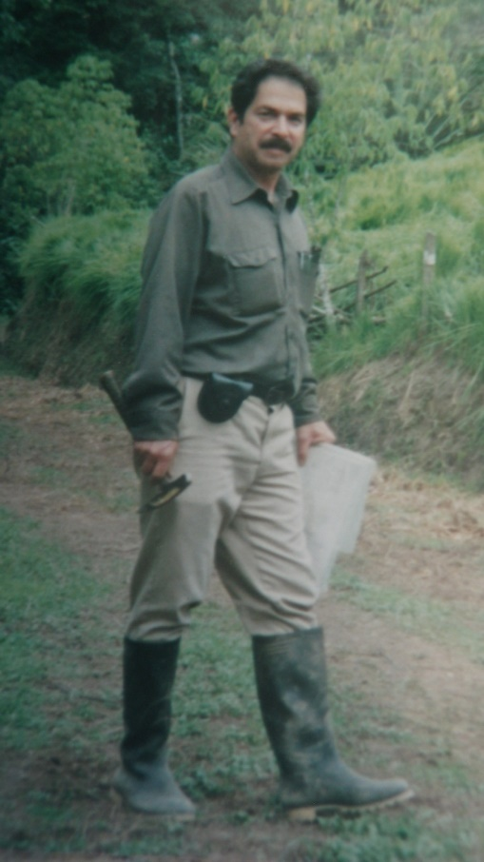
Very Personal Impact – Friendship
Geologists Chris Westerman and Bob Hewton, and mining engineer Robert Rivera died in the crash
March 1994
Notes:
Vancouver based consultants Chris Westerman and Bob Hewton and mining engineer Robert Rivera died in the crash

Slide 8
How did it all start
Late career at Noranda-Falconbridge as Chief Geologist and responsible for global H&S reporting
A question from the senior executives was “how do we (Noranda exploration) compare with industry as a whole”?
I found no one knew the answer
2004 - proposed to PDAC we form a national H&S committee
We went to AME and asked to take their H&S survey national

Slide 9
Two Data Sets
The Annual Survey
  Company responses
The Fatality Database
  From whatever information can be found

Slide 10
Who has the accidents?
Generally younger or junior people
Key points:
Drill helpers, drillers and Field Assistants have more frequent and more serious accidents
Experienced workers have less frequent and less serous accidents in each category

Slide 11
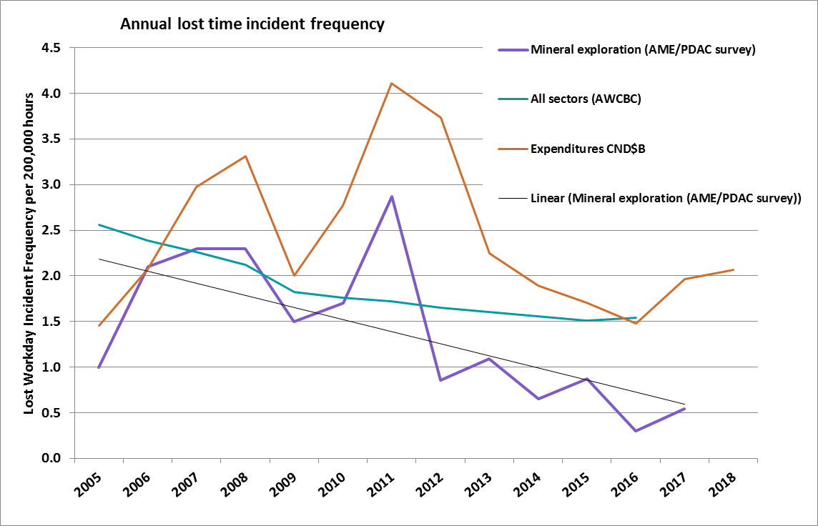
High expenditures lead to high accident frequency
LTI Incident rates to 2018

Slide 12
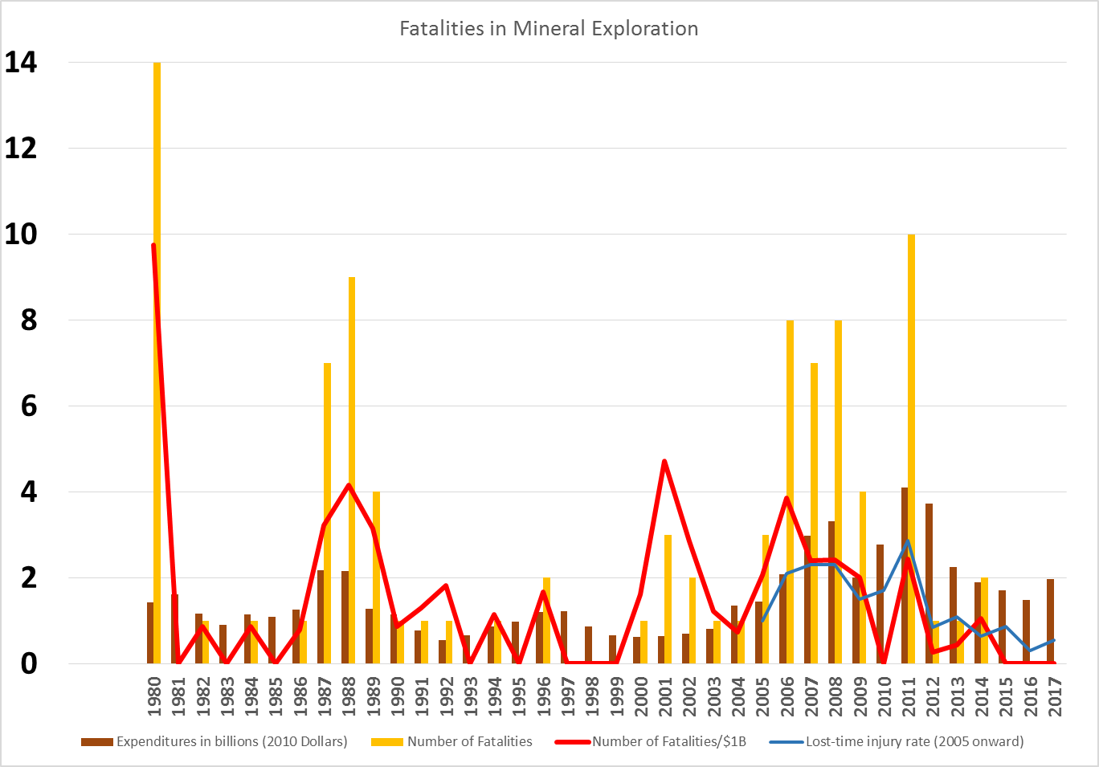
FATALITIES 1980-2018 (MINERAL EXPLORATION, CANADA ONLY)
Question:
What is the relationship of expenditure trends to accident rates?
Number of fatalities
Number of fatalities/$B
Lost Time Injury Rate
Expenditures
CND$B

Slide 13
My conclusions
Junior workers appear to have more accidents
  Are senior workers taking their responsibilities seriously enough?
Accident and fatality rates are higher in “boom” times
  More inexperienced workers (“drill helper hired off the street”)
  More temptation to cut corners and spend money faster

Slide 14
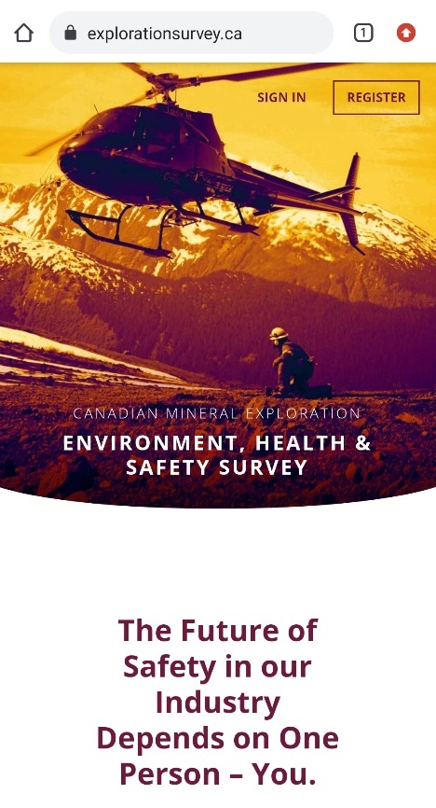
Explorationsurvey.ca
Dedicated web portal
Ability to import or enter incident data
Incident report comparing submission to industry at large

Slide 15
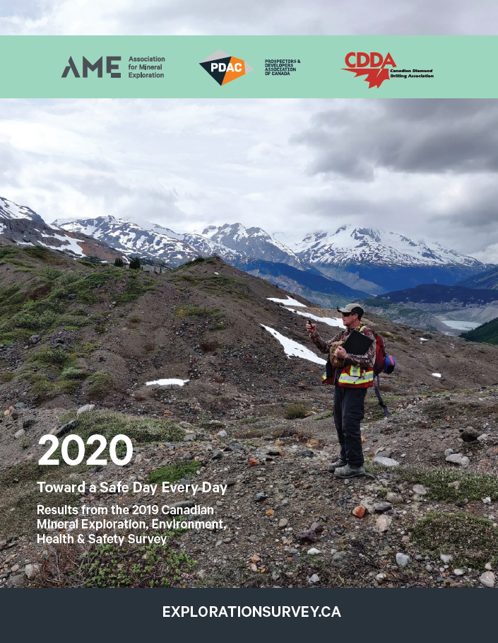


The 2019 Survey
67 surveys – down 43% from 2018
8.9 million hours reported –
down 10%
57 awards
  2 Gold
  21 Silver
  34 Bronze

Slide 16
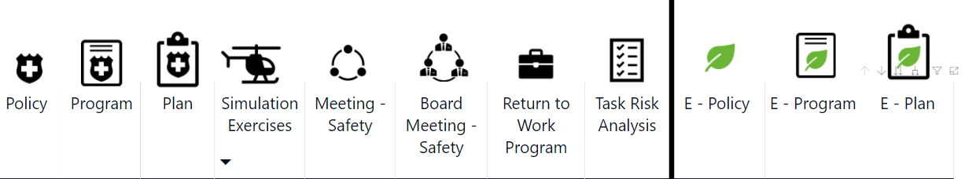
Drilling into the Data
10 drilling companies filled out 2019 survey
In general terms, similar to producing mining companies in terms of leading indicators
  Policies, planning, always discussing safety at board meetings

Slide 17
Drilling into the Data
Drilling companies reported:
53% of hours
44% of incidents
47% of injuries
Drilling activities accounted for:
53% of injuries
(68% reported by drilling companies;
32% reported by exploration and mining companies)

Slide 18
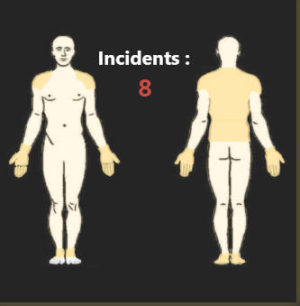
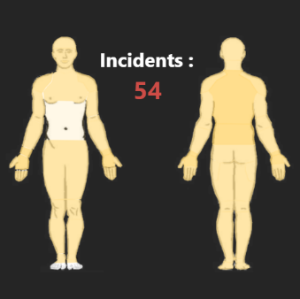
What can we learn from the data?
LTIs
RWIs
Engineering controls have made drilling safer, but still various causes of injury
Repetitive activities account for 19 of 54 RWIs
Key words:
  Pinch, caught, fell

Slide 19
Uses
Can inform companies' own programs
Used to develop AME, PDAC tools, short courses
AME, PDAC, CDDA keen to achieve safety in mineral exploration through other uses.

Slide 20
The Databases
The annual survey
  Over 5000 incidents from hundreds of companies
The fatality data
  About 100 fatalities from 1980 to 2020
Turned to CROSH for detailed intense study of this information
Driving whole exploration industry towards zero harm

Slide 21

Center for Research in Occupational Safety and Health (CROSH)

Slide 22
Thesis Project: Mission
Have an all-encompassing knowledge of the nature of the workplace, allowing us researchers and fellow occupational health and safety advocates to mutually understand the many ways in which incident reports are relevant

Slide 23
Thesis Project: Analysis
Cleanup, recoding and exploration of data set
Historical incidents and safety philosophies
Insight from companies
  Interviews
  Field visits
  Economic metrics
Trend analysis and statistical outcomes
Report findings

Slide 24
Thesis Project: Possible Outcomes
How and why this data is valuable
Highlight areas of importance and concern
Target safety messaging and/or training
Mitigate risk in the field
Promote a safer work environment
Correlation between production and workplace injuries

Slide 25
The Benefits of Collaboration
Company → Management → Supervisor → Worker
Student learning, experience and interaction
Ultimately, incident reports and data sets hold knowledge that will be powerful if examined closely, which is exactly what our research hopes to show

Slide 26
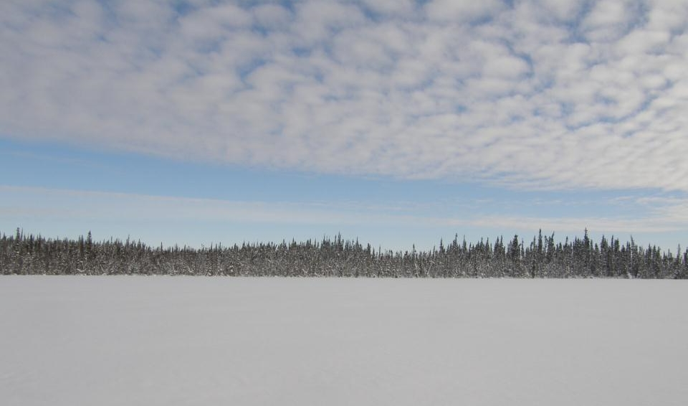



THANK YOU!
Jonathan Buchanan, Director, Regulatory and Technical Policy, AME
Bill Mercer, Chair, PDAC Health and Safety Committee [VP-Operations, Avalon)
Rebecca Bond, CROSH, Laurentian University

Slide 27
How corrosion affects the mining industry
Presentation by: Zoe Coull PhD PEng, Professional Engineer and Brycklin Wilson, MaSc, PEng, Senior Corrosion Specialist

Slide 28
4th Quarter 2020 Safety Awards

Slide 29
2020 Q4 Surface
Over 100k Hours
Geotech Drilling Ltd.
30k - 100k Hours
Equity Drilling
Under 30k
Priority Drilling
Notes:
Over all frequency was 5.5

Slide 30
2020 Q4 Underground
Over 100k
No Qualifiers
30k - 100k Hours
Foraco
Under 30k
Hy-Tech Drilling Ltd.
Notes:
Over all frequency was 4.3

Slide 31
Thank you and Adjournment
Notes:
Over all frequency was 4.3

